Slide 1

Accessibility
Lecturer
Rokas Slaboševičius
Data

Slide 2
Today you will learn
Accessibility
Public
Protected
01
04
Private
Sealed
02
05
Internal
03

Slide 3
Access modifiers
Accessibility
Declared accessibility | Meaning
public | Accessible from anywhere in the code
protected | Can be accessed from within the class or from within the inheriting class
internal | Can be accessed from the current project (Specifically Assembly)
protected internal | Can be accessed from the current project (Specifically Assembly) or successor classes
private | Accessible only from inside the classroom
private protected | Can be accessed from within a class or from child classes in the same project (Specifically Assembly)

Slide 4
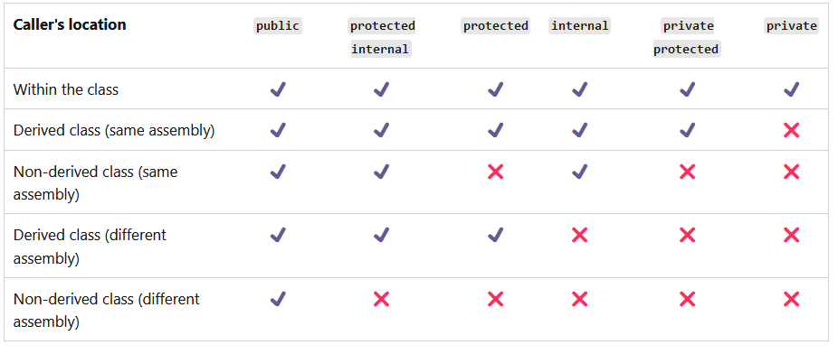
Access modifiers
Accessibility

Slide 5


Access modifiers
Accessibility
Access modifiers can be used for resources that can be accessed externally, such as classes, methods, fields, etc.
To add or change an access modifier for any of our call resources, we need to add one of the available access modifiers. For example: public class User()
Access modifiers must be used to specify the level of accessibility of a resource

Slide 6
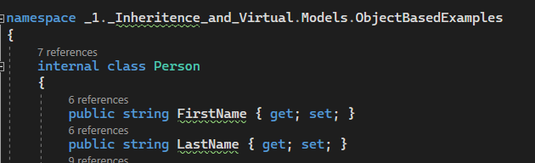
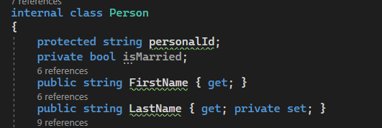
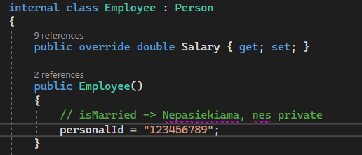
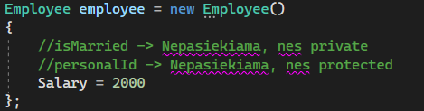
Access modifiers
Accessibility
Resources at the direct namespace level as a class, record or struct can be: public or internal
The "members" of a direct namespace-level resource, such as properties, methods and others, can be augmented with any accessibility modifiers.

Slide 7

Accessibility
Task 1
Create a class called "Person" with private fields "name" and "age". You can access and set access to these fields using properties with accessibility modifiers "public" and "private" respectively.
Extend the Person class from the previous exercise by adding a protected method called "PrintInfo()", which prints the person's name and age.
Create a class called "Student" as a derived class from "Person". Access to the "name" and "age" fields should be through protected properties. Add a new private property "studentId" and a public method called "GetStudentId()" which returns the student's identification number.
Create another class called "Teacher". Access to the "name" and "age" fields should be through protected properties. Add a new private property "subject" and a public method called "GetSubject()" which returns the name of the subject to be taught.

Slide 8
Accessibility
Task 2
Create a class called "BankAccount" with the private field "balance". You can access and set the balance field via public properties, but only methods of the base class can set the balance.
Extend the BankAccount class from the previous exercise by adding a protected method called "PrintBalance()", which prints the account balance.
Create a class called "SavingsAccount" as a derived class from "BankAccount". Access to the "balance" field should be via the protected property. Add a new private property called "interestRate" and a public method called "CalculateInterest()" that calculates the interest and adds it to the account balance.
Create another class called "CheckingAccount". Access to the "balance" field should be through the protected property. Add a new private property called "overdraftLimit" and a public method called "Withdraw()" that allows to withdraw money from the account based on the overdraftLimit.

Slide 9
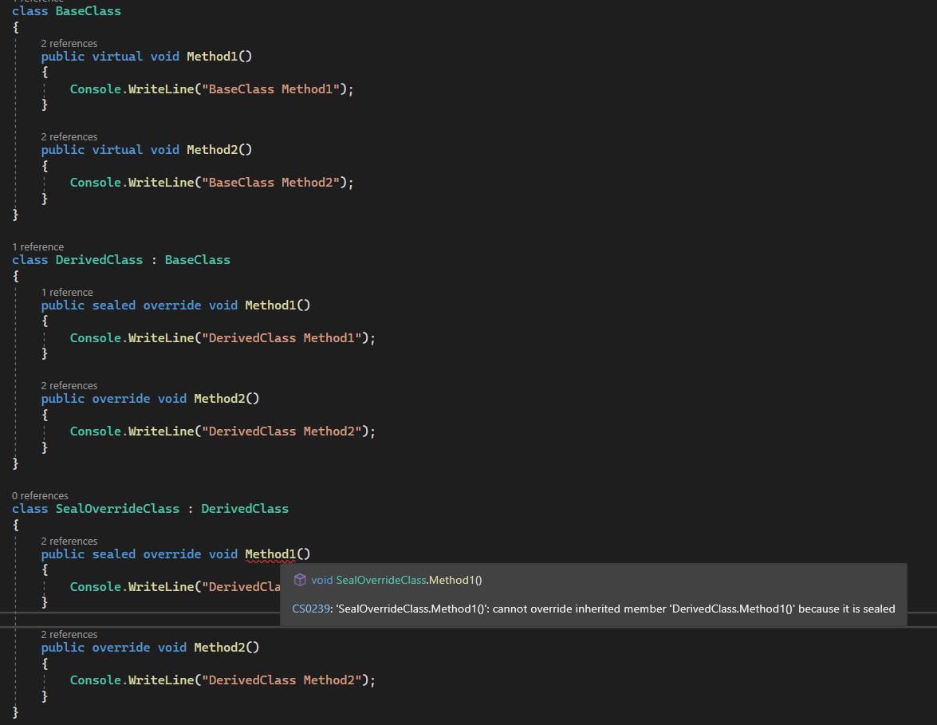
Sealed
Accessibility
In C# programming, a sealed word is a modifier that is used with virtual methods and classes.
When a virtual method or class is marked as locked, it means that inheritance and overwriting is prohibited.

Slide 10
Accessibility
Task 3
Create a base class called "Shape" with the virtual method "CalculateArea()". Implement this method to return the area. Create a derived class named "Circle" which inherits from "Shape" and overrides the method "CalculateArea()". This class must lock the CalculateArea() method to ensure that the method cannot be overridden again.
Create a base class called "Animal" with the virtual method "MakeSound()". Implement this method to output the sound of the animal. Create a derived class named "Dog" which inherits from "Animal" and overrides the method "MakeSound()". Lock the "MakeSound()" method so that no additional derived classes can be created with dog sounds.

Slide 11
Accessibility
Task 4
Create a base class called "Employee" with the virtual method "GetSalary()". Implement this method to return the employee's salary. Create a derived class called "Manager" which inherits from "Employee" and overrides the method "GetSalary()". Also create another derived class called "Developer" which also inherits from "Employee" and overrides the "GetSalary()" method. Lock the "GetSalary()" method in both derived classes so that it can no longer be overridden and to ensure that only a unique salary is returned for each class.

Slide 12
Accessibility
https://learn.microsoft.com/en-us/dotnet/csharp/language-reference/keywords/accessibility-levels
https://learn.microsoft.com/en-us/dotnet/csharp/programming-guide/classes-and-structs/access-modifiers
https://learn.microsoft.com/en-us/dotnet/csharp/language-reference/keywords/sealed
Useful information

